Slide 1
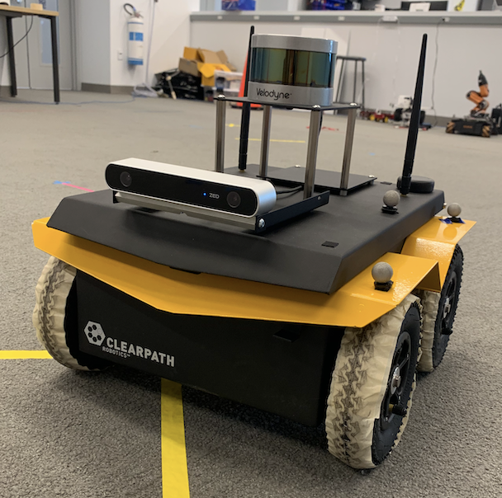
Real Time 3D Mapping
ZED Stereo Camera & JACKAL
#SLAM
#Computer_Vision
#ROS #Python #C++
#Self_Driving
#JACKAL #ZED
# LIDAR
MINYOUNG CHANG
ANDY CHOI

Slide 2
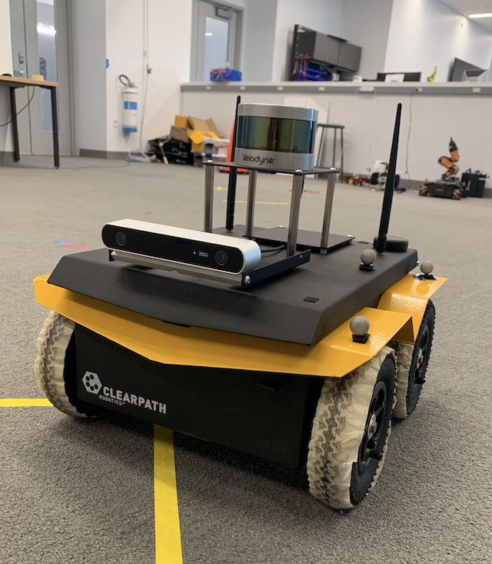
HARDWARE SETUP
PUCK VLP-16 LIDAR Sensor
< Velodyne >
ZED Stereo Camera
< STEREO LABS >
JACKAL
< CLEARPATH >

Slide 3
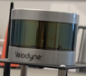
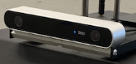
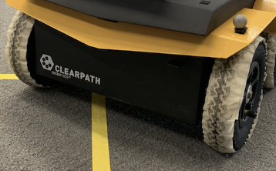
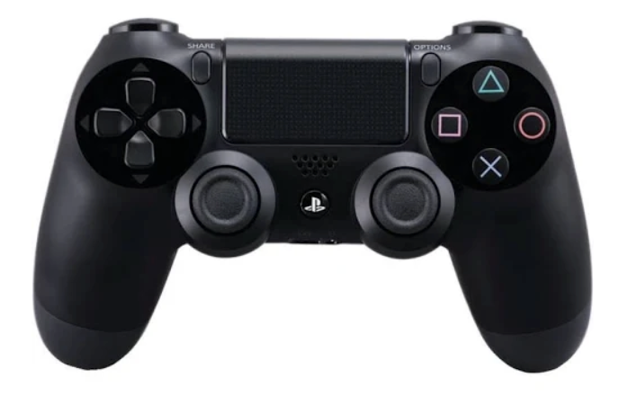
SYSTEM SETUP
LIDAR
/sensor_msgs/PointCloud2
RVIZ
ZED CAMERA
/rgb/image_rect_color
/depth/depth_registered
RTABMAP
/rtabmap/MapData
/odometry/filtered
JACKAL
CONTROLLER
/cmd_vel

Slide 4
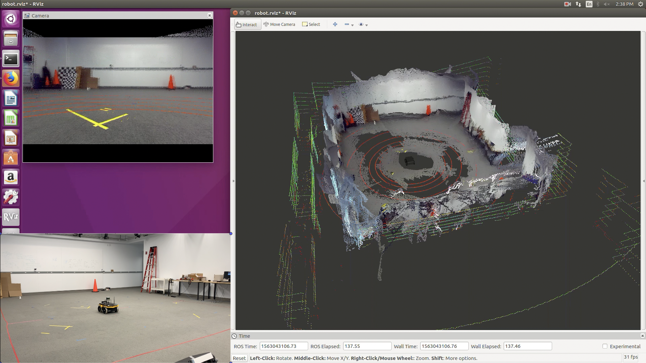
SCREEN LAYOUT
RVIZ
LIDAR
Point Cloud
RTABMAP
Point Cloud
ZED Camera View
JACKAL
Real View

Slide 5
Help from Mathieu Labbe (RTABMAP)
CLEARPATH
STEREO LAB
http://wiki.ros.org/rtabmap_ros/Tutorials/HandHeldMapping
https://github.com/introlab/rtabmap/wiki/Tutorials
http://wiki.ros.org/rtabmap_ros/Tutorials/SetupOnYourRobot
Reference

